Slide 1
Reliability of a Flow Network Subject to
Budget Constraints
Y. K. Lin
IEEE TRANSACTIONS ON RELIABILITY, Vol. 56, No. 1, pp. 10-16, 2007
Reporter: Chiou-Ting Tseng
Date: May 2, 2007

Slide 2
Abstract
The system capacity of a deterministic flow network is the maximum flow from the source to the destination. In a single-commodity stochastic-flow network (branches all have several possible capacities, and may fail), the system reliability, the probability that the maximum flow is larger than or equal to a given demand, is an important performance index to measure the quality level of a network. In a two-commodity stochastic-flow network, different types of commodities are transmitted through the same network simultaneously, and compete for the capacities.

Slide 3
Abstract
We concentrate on the reliability problem for such a network subject to the budget constraint. This paper defines firstly the system capacity as a pattern. We propose a performance index, the probability that the system capacity is less than or equal to a given pattern subject to the budget constraint, to evaluate the system performance. A simple algorithm based on minimal cuts is proposed to generate all maximal vectors meeting the demand and budget constraints. The performance index can then be computed in terms of all such maximal vectors.

Slide 4
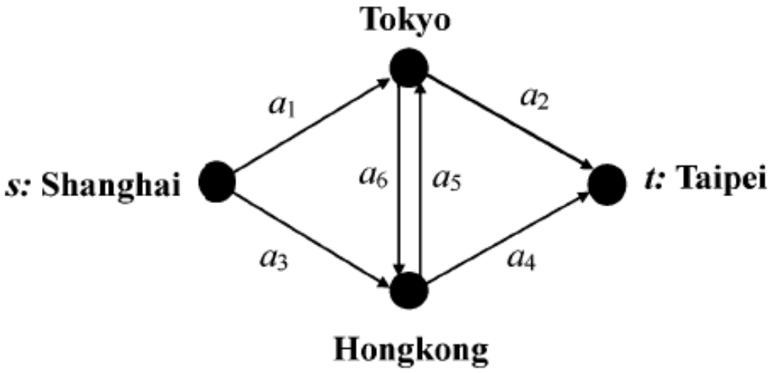
Stochastic-Flow Network
The branch capacity should be stochastic due to the fact that the branch may be in failure, maintenance, etc.

Slide 5
System reliability
The probability that the system capacity is larger than or equal to the demand (integer).

Slide 6
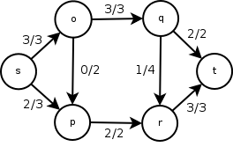
Max-flow min-cut Theorem
The maximum value of the flow from to equals the minimum capacity among all MC.
Cut | Capacity
S = {s,p},T = {o,q,r,t} | c(s,o) + c(p,r) = 3 + 2 = 5
S = {s,o,p},T = {q,r,t} | c(o,q) + c(p,r) = 3 + 2 = 5
S = {s,o,p,q,r},T = {t} | c(q,t) + c(r,t) = 2 + 3 = 5
S = {s,o,p,r},T = {q,t} not

Slide 7
Unreliability
The probability that the system capacity is less than or equal to d.
By generating all maximal capacity vectors which enable the system to transmit exactly d flow from s to t.

Slide 8
Multi-commodity
However, many SFN allow multiple types of commodity to be transmitted from to simultaneously, especially in the case that different commodities consume the branch’s capacity differently.
For instance, a broadband computer network is a typical TSFN in which two-commodity (audio files denote commodity 1, video files denote commodity 2) share the bandwidth (capacity) simultaneously.

Slide 9
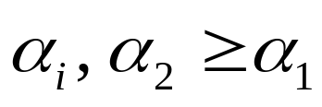
Assumptions
The current capacity x_{i} is an integer-valued random variable which takes the value from {0, 1, ..., M_{i} } according to a given probability distribution.
Without loss of generality for .
Two types of commodities are transmitted from s to t.
The capacities of different branches are statistically independent.
The flow in must satisfy the flow-conservation law.

Slide 10
Example
Send 15’ LCD’s and 17’ LCD’s from Shanghai to Taipei.
15’ LCD costs 1 capacity, 17’ LCD costs 2 capacity.
Maximal capacity = {4, 3, 3, 4, 3, 3}
Minimal cut: {a₁, a₃}, {a₂, a₄}, {a₁, a₄, a₅}, {a₂, a₃, a₆}
Number to send: 2, 2
Budget = 4400

Slide 11
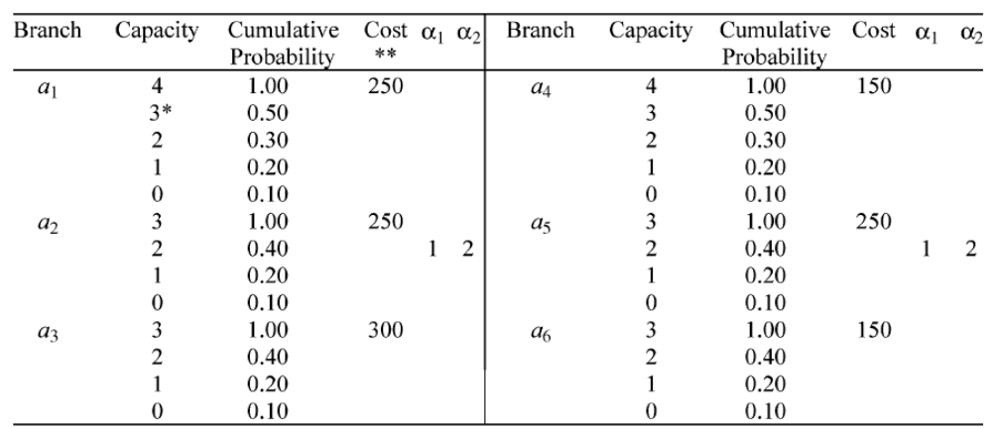
Parameter

Slide 12
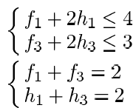
Step 1, K₁={a₁, a₃}
Step 1.1: find(f₁, h₁, f₃, h₃)
(1, 1, 1, 1), (2, 0, 1, 1), and (0, 2, 2, 0)

Slide 13
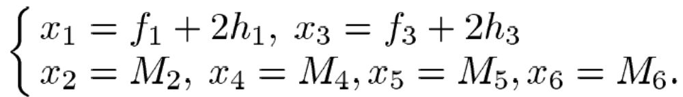
Step 1.2
(1, 1, 1, 1), (2, 0, 1, 1), and (0, 2, 2, 0)
Transform into X by
X₁={3, 3, 3, 4, 3, 3}, X₂={4, 3, 2, 4, 3, 3}
C(X₁)=3*250+3*250+3*300+4*150+3*250+3*150=4200<4400, C(X₂)=4150<4400

Slide 14
Step 1
Apply to M₂ = {a₂, a₄}, M₃ = {a₁, a₄, a₅}, and M₄ = {a₂, a₃, a₆}

Slide 15
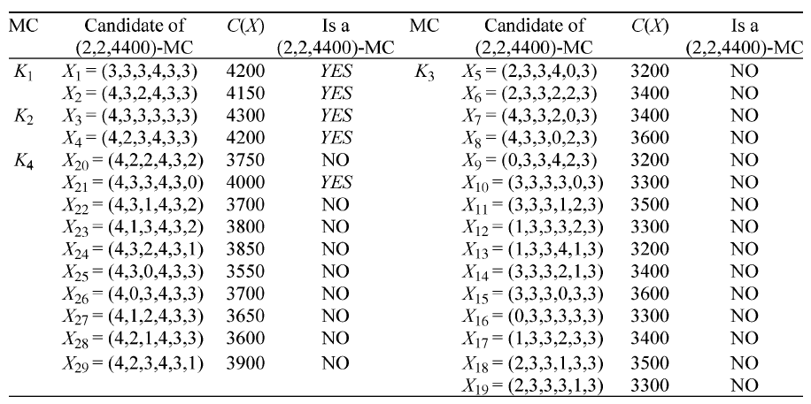
Step 2

Slide 16
Reliability
Pr{X≤(3, 3, 3, 4, 3, 3)}=0.5*1*1*1*1*1
Pr{X≤(3, 3, 3, 4, 3, 3)∩X≤(4, 2, 3, 4, 3, 3)}
= Pr{X≤(3, 2, 3, 4, 3, 3)} = 0.5*0.4*1*1*1*1 = 0.2
Reliability = Pr{B₁∪B₂∪B₃∪B₄∪B₅}=0.919

Slide 17
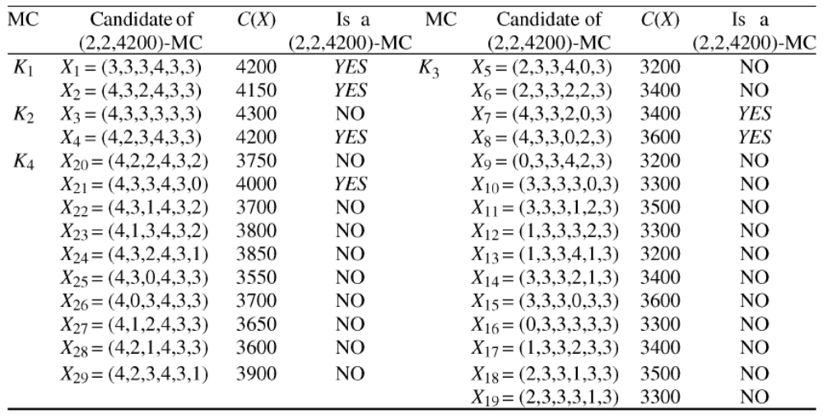
(2, 2, 4200)
Realibility= 0.84772

Slide 18

Complexity
Number of MC
Space Complexity: O(nΨ)
Transfer into X: O(nΨ) time
Find maximal MC: O(nΨ²)
Time Complexity: O(nΨ²)

